Slide 1
INDIAN CUISINE
Hunt for Indian Restaurants in AUSTRIA
Author : Deepankar Singh

Slide 2
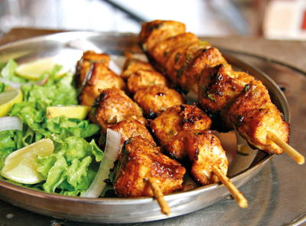
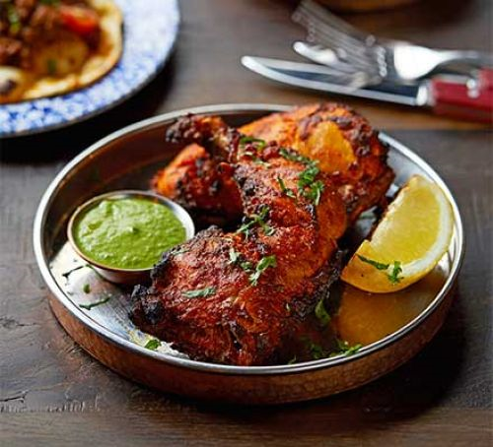

INTRODUCTION
“There is no love sincerer than the love of food” – George Bernard Shaw

Slide 3
BUSINESS PROBLEM
The founder of one of the best Influencers and Food Community of India ‘SpicyTadka’ began her career with leading news channels like headlines today, Times Now and News X. After working for 7 years, she decided to pursue her passion for photography and blogging, eventually leading to Food Photography and Food Community. During her visit to Europe, she wanted to make a blog about the Indian food in Europe. And, they wanted to start their blog from the Centre of Europe – AUSTRIA.
So, the team of ‘SpicyTadka’ requested our Data Science team to find out the Best Indian Restaurant in AUSTRIA.

Slide 4

INTEREST
The Indian Food Bloggers and Food Explorers across the Europe would be very interested to know about the Best Indian Restaurant in Austria so that they can explore and can make their blogs as well in the future. Also, the Indian Community and travelers who are in Austria and searching for Indian Food would get to know the best Indian Restaurants.

Slide 5
DATA
For providing the options for best Indian Restaurants in Austria to our client, we are using the data from Simplemaps.com & Foursquare API.
Simplemaps.com
Has a World Cities Database and it offers a simple, accurate and up-to-date database of the world's cities and towns, which they have built it from the ground up using authoritative sources such as the NGIA, US Geological Survey, US Census Bureau, and NASA. We have taken the data for 81 cities of Austria and their coordinates from the website and save it our Git Hub repository. Below are the Links for both.
Simplemaps.com : https://simplemaps.com/data/at-cities Git Hub Repository : https://github.com/Ekdeep0712/Capstone-Project-Coursera/blob/master/at.csv

Slide 6
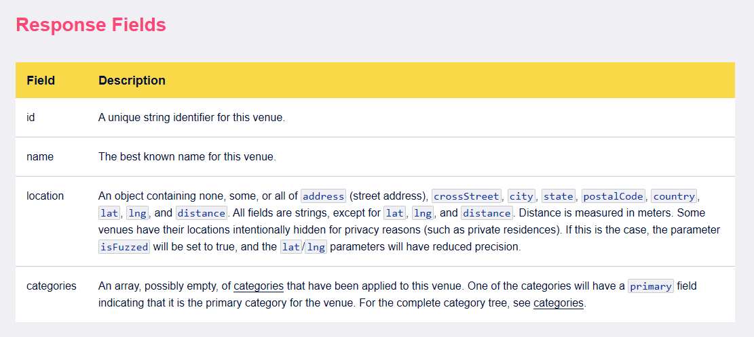
DATA
Foursquare API
For this project we are also using Foursquare API. Foursquare is a social location service that allows users to explore the world around them. One of the best characteristics of this API is, it can provide you the list of venues based on the coordinates and radius given. By using the “explore” feature with correct parameters, will give you a JASON file mentioning the below information.
We used Foursquare to find the list of Indian Restaurants in Austria and to find the ratings of the restaurants.

Slide 7
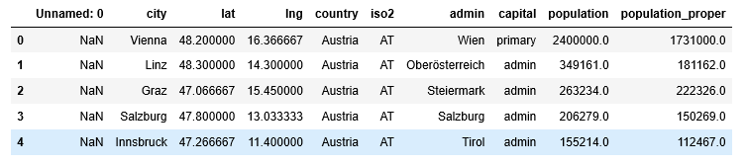
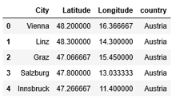
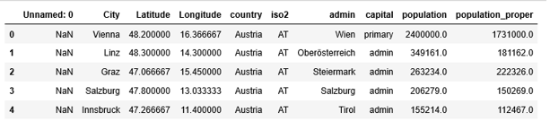
METHODOLOGY Data Preprocessing
We downloaded the data containing cities, population & coordinates of Austria. After renaming the column names, we removed the columns which we don’t need. Finally we got the new data set with needed information.

Slide 8
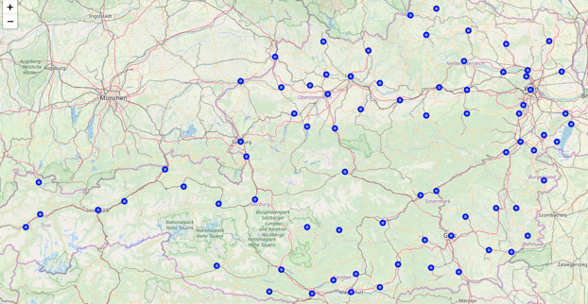
METHODOLOGY Exploratory Data Analysis
After fetching the Geographical Coordinates of Austria, we used python folium library & created a map of Austria with cities superimposed on top.

Slide 9
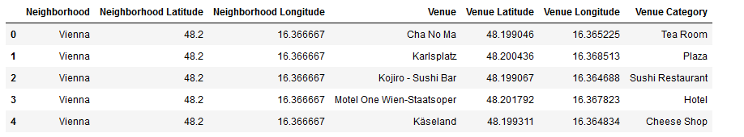
METHODOLOGY Exploratory Data Analysis
We created a function to check the venues in all the cities present in our data frame. As per our new dataset we have total 1196 venue categories returned by Four square API. Below is the head of our data set.

Slide 10
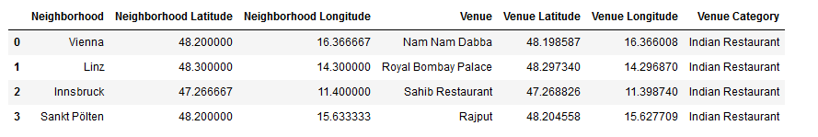
METHODOLOGY Exploratory Data Analysis
As per our need, we filtered all the categories containing the “Indian” in its name as we are looking only for Indian Restaurants in Austria. And we received the below result.

Slide 11
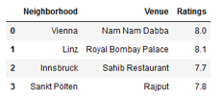




RESULTS
As a result, we only received the 4 Indian Restaurants in Austria according to Foursquare API.
With the help of Foursquare API Venue ID Function, we fetched the overall ratings of all Restaurants and below is the final Data set.

Slide 12

DISCUSSION
After creating a function to check the venues in all the cities present in our data frame and after creating a new dataset with all the information along with coordinates, we were able to filter the venue categories and found the categories which have common name “Indian Restaurant”.
We found only 4 Indian Restaurants from 80 cities in Austria, so it was very easy for us to filter the best restaurant according to overall ratings.
We also visualized the map of restaurants we found in Austria with the cities they are located in.

Slide 13

CONCLUSION
We were able to give best option to our client for the Indian Restaurants. So that, they will make their next food blog and can able to explore the different and best Indian dishes served in the best Indian Restaurant of Austria.
They can also show the exact location, ambience and best dishes served through their videos and blogs to the Indian travelers and community who are in search of good Indian Food.
During this project we have used different Data Wrangling Methodologies with Pandas & Folium for map visualization. For the future projects with similar characteristics, it should be considered to expand the amount of data and Machine Learning Algorithms. For. eg. K Means Clustering, DBSCAN etc.

Slide 14

Deepankar Singh
Coursera Capstone Project

